Slide 1
DOM

Slide 2
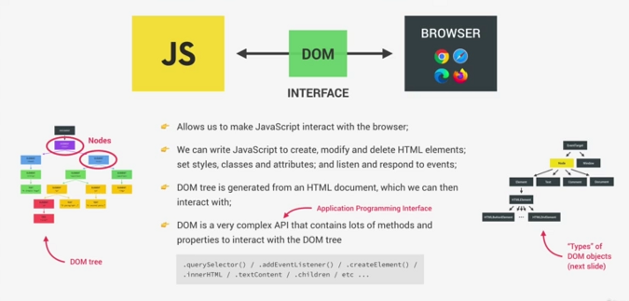

Slide 3
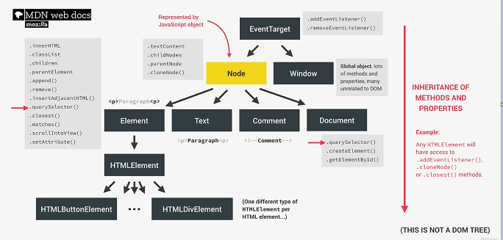

Slide 4
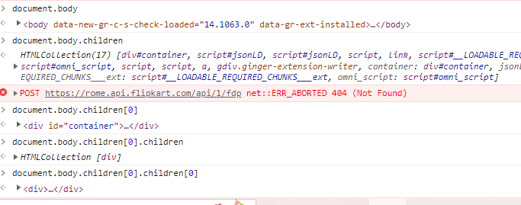
HTML DOM

Slide 5
What we can do using DOM?
Using DOM, JavaScript gets all the power it needs to create/update HTML:
JavaScript can change all the HTML elements in the page
JavaScript can change all the HTML attributes in the page
JavaScript can change all the CSS styles in the page
JavaScript can remove existing HTML elements and attributes
JavaScript can add new HTML elements and attributes
JavaScript can react to all existing HTML events in the page

Slide 6
DOM Methods
HTML DOM methods are actions you can perform (on HTML Elements)
HTML DOM properties are values (of HTML Elements) that you can set or change
<html>
<body>
<p id="demo"></p>
<script>
document.getElementById("demo").innerHTML = "Hello World!";
</script>
</body>
</html>
innerHTML is a property
getElementById is a method

Slide 7
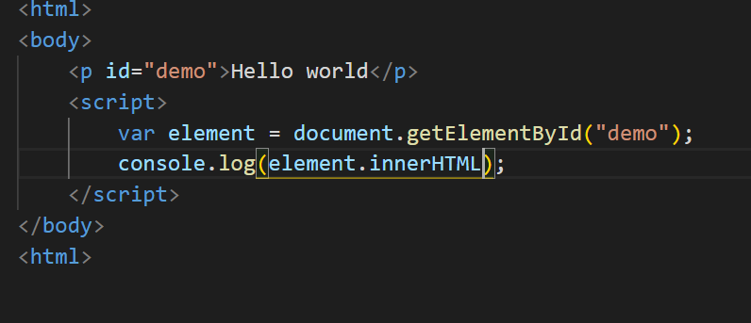
getElementById

Slide 8
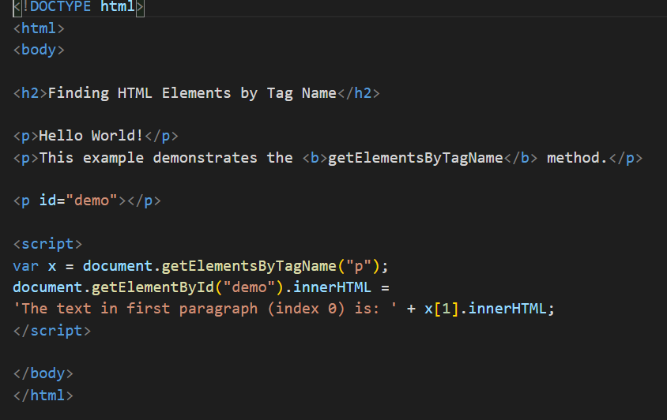
getElementsByTagName

Slide 9
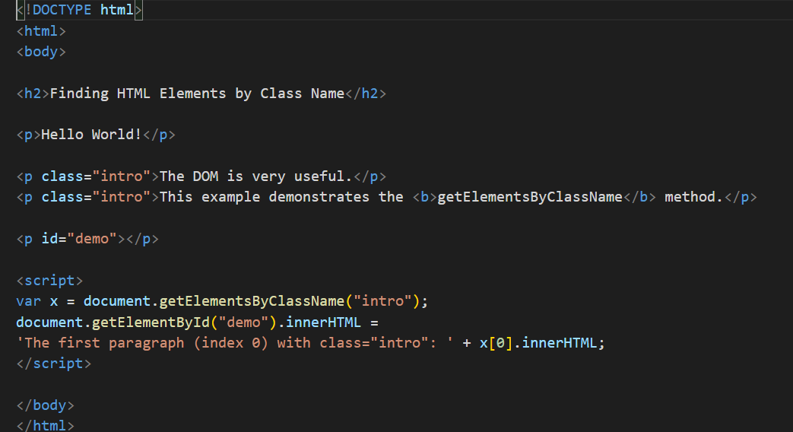
getElementsByClassName

Slide 10
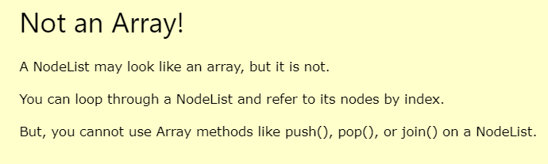
NodeList

